Slide 1
Trapezium and Diagonals
Inspired by a problem in:
40 Harder Problems for the Classroom, Derek Ball (2005), ATM

Slide 2
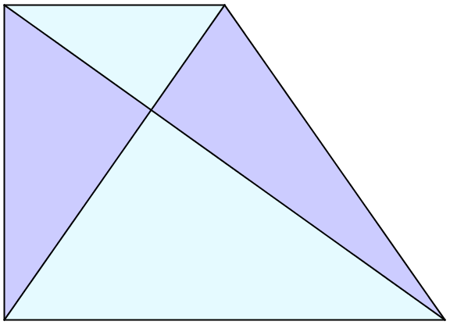




Trapezium and Diagonals
$$18$$
Not to scale
$$B$$
$$A$$
$$50$$
In this trapezium what are the areas A and B?

Slide 3
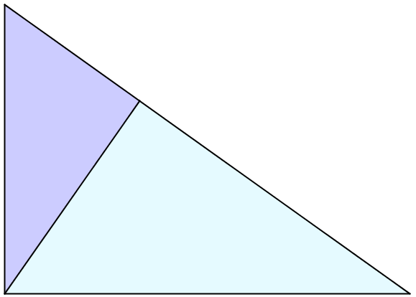
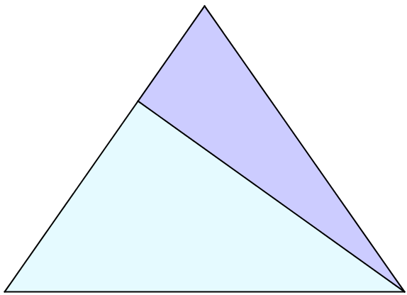
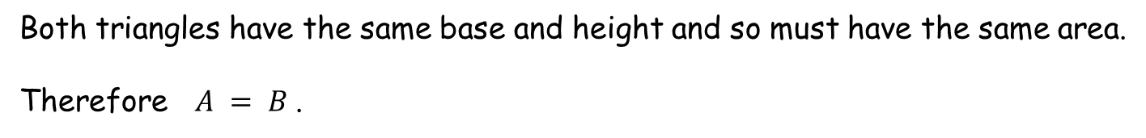




Trapezium and Diagonals
Consider these two triangles…
$$A$$
height
$$B$$
$$50$$
$$50$$
base
base
Both triangles have the same base and height and so must have the same area.
Therefore $A = B$.

Slide 4








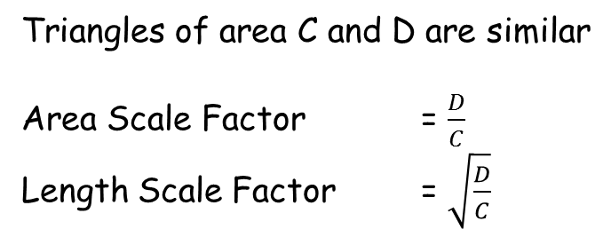

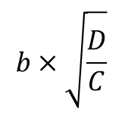
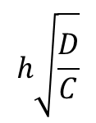
Trapezium and Diagonals
$$b$$
$A=B$ , previously.
$$h$$
$$C$$
Triangles of area C and D are similar
Area Scale Factor = $\frac{D}{C}$
Length Scale Factor = $\sqrt{\frac{D}{C}}$
$$A$$
$$A$$
$$B$$
$$h\sqrt{\frac{D}{C}}$$
$$D$$
$$b×\sqrt{\frac{D}{C}}$$
Area of trapezium $=2A+C+D$
And also $=\frac{1}{2}\left(b+b\sqrt{\frac{D}{C}}\right)\left(h+h\sqrt{\frac{D}{C}}\right)$

Slide 5
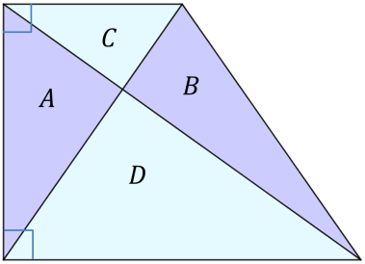

Trapezium and Diagonals
Area of trapezium $=2A+C+D$
And also $=\frac{1}{2}\left(b+b\sqrt{\frac{D}{C}}\right)\left(h+h\sqrt{\frac{D}{C}}\right)$
$=\frac{1}{2}bh\left(1+\sqrt{\frac{D}{C}}\right)\left(1+\sqrt{\frac{D}{C}}\right)$
$=C\left(1+2\sqrt{\frac{D}{C}}+\frac{D}{C}\right)$
$=C+2\sqrt{CD}+D$
So $2A+C+D=C+2\sqrt{CD}+D$
And $A=B=\sqrt{CD}$

Slide 6




Trapezium and Diagonals
There is an easier way to solve this problem!
$$C$$
$$B$$
$$A$$
$$D$$
These triangles have the same perpendicular height, so their areas are in the same ratio as that of their bases.
Perpendicular height
base
base

Slide 7




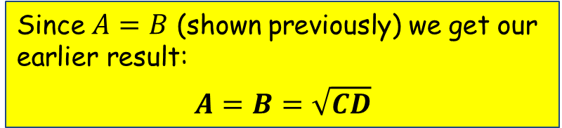

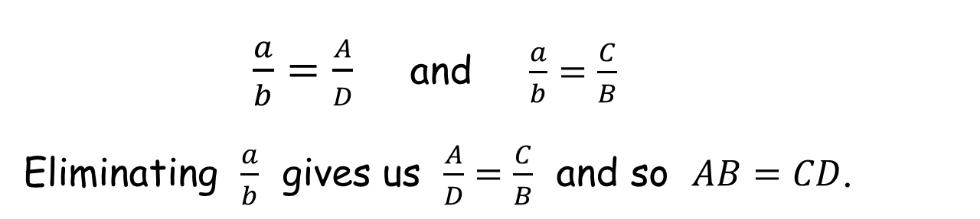


Trapezium and Diagonals
There is an easier way to solve this problem!
$$C$$
$$a$$
$$B$$
$$A$$
Introducing the lengths $a$ and $b$ that make up the diagonal shown, can you find two relationships between $a$ and $b$ ?
$$b$$
$$D$$
$\frac{a}{b}=\frac{A}{D}$ and $\frac{a}{b}=\frac{C}{B}$
Eliminating $\frac{a}{b}$ gives us $\frac{A}{D}=\frac{C}{B}$ and so $AB=CD$.
Since $A=B$ (shown previously) we get our earlier result:
$$A=B=\sqrt{CD}$$

Slide 8
Trapezium and Diagonals
What was the significance of the right angles?
$$18$$
$$B$$
$$A$$
$$50$$
In this trapezium what are the areas A and B?

Slide 9
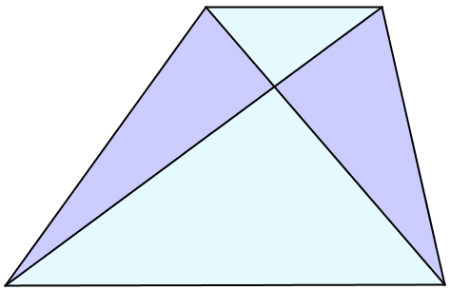


Trapezium and Diagonals
What was the significance of the right angles?
There was none!
All of our previous reasoning applies in this situation as well.
$$18$$
$$A$$
$$B$$
$$50$$
In this trapezium what are the areas A and B?

Slide 11
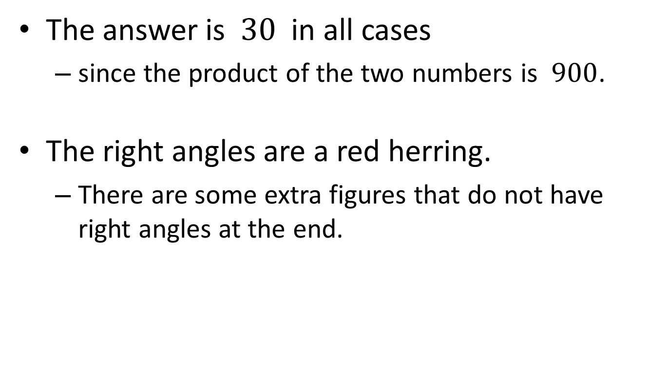
Note to Teacher
The answer is $30$ in all cases
since the product of the two numbers is $900$.
The right angles are a red herring.
There are some extra figures that do not have right angles at the end.

Slide 12
Resources

Slide 13




Trapezium and Diagonals
$$18$$
Not to scale
$$B$$
$$A$$
$$50$$
In this trapezium what are the areas $A$ and $B$?
SIC_7

Slide 14


Trapezium and Diagonals
$$15$$
Not to scale
$$B$$
$$A$$
$$60$$
In this trapezium what are the areas $A$ and $B$?
SIC_7

Slide 15


Trapezium and Diagonals
$$12$$
Not to scale
$$B$$
$$A$$
$$75$$
In this trapezium what are the areas $A$ and $B$?
SIC_7

Slide 16


Trapezium and Diagonals
$$9$$
Not to scale
$$B$$
$$A$$
$$100$$
In this trapezium what are the areas $A$ and $B$?
SIC_7

Slide 17


Trapezium and Diagonals
$$20$$
Not to scale
$$B$$
$$A$$
$$45$$
In this trapezium what are the areas $A$ and $B$?
SIC_7

Slide 18


Trapezium and Diagonals
$$25$$
Not to scale
$$B$$
$$A$$
$$36$$
In this trapezium what are the areas $A$ and $B$?
SIC_7

Slide 19


Trapezium and Diagonals
$$10$$
Not to scale
$$B$$
$$A$$
$$90$$
In this trapezium what are the areas $A$ and $B$?
SIC_7

Slide 20


Trapezium and Diagonals
$$5$$
Not to scale
$$B$$
$$A$$
$$180$$
In this trapezium what are the areas $A$ and $B$?
SIC_7

Slide 21


Trapezium and Diagonals
$$27$$
Not to scale
$$B$$
$$A$$
$$33\frac{1}{3}$$
In this trapezium what are the areas $A$ and $B$?
SIC_7

Slide 22


Trapezium and Diagonals
$$24$$
Not to scale
$$B$$
$$A$$
$$37\frac{1}{2}$$
In this trapezium what are the areas $A$ and $B$?
SIC_7

Slide 23


Trapezium and Diagonals
$$21$$
Not to scale
$$B$$
$$A$$
$$42\frac{6}{7}$$
In this trapezium what are the areas $A$ and $B$?
SIC_7

Slide 24


Trapezium and Diagonals
$$21\frac{3}{7}$$
Not to scale
$$B$$
$$A$$
$$42$$
In this trapezium what are the areas $A$ and $B$?
SIC_7

Slide 25


Trapezium and Diagonals
$$18\frac{3}{4}$$
Not to scale
$$B$$
$$A$$
$$48$$
In this trapezium what are the areas $A$ and $B$?
SIC_7

Slide 26


Trapezium and Diagonals
$$12\frac{1}{2}$$
Not to scale
$$B$$
$$A$$
$$72$$
In this trapezium what are the areas $A$ and $B$?
SIC_7

Slide 27


Trapezium and Diagonals
$$7\frac{1}{2}$$
Not to scale
$$B$$
$$A$$
$$120$$
In this trapezium what are the areas $A$ and $B$?
SIC_7

Slide 28


Trapezium and Diagonals
$$13\frac{1}{2}$$
Not to scale
$$B$$
$$A$$
$$66\frac{2}{3}$$
In this trapezium what are the areas $A$ and $B$?
SIC_7

Slide 30
EXTRAS

Slide 31
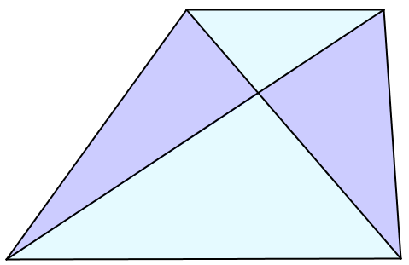




$$18$$
$$A$$
$$B$$
$$50$$
Not to scale
In this trapezium what are the areas A and B?
SIC_7
Notes:
18 50

Slide 32




$$15$$
$$A$$
$$B$$
$$60$$
Not to scale
In this trapezium what are the areas A and B?
SIC_7
Notes:
15 60

Slide 33
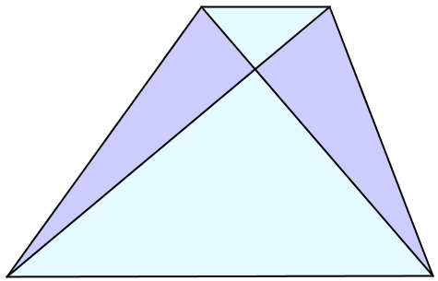




$$12$$
$$A$$
$$B$$
$$75$$
Not to scale
In this trapezium what are the areas A and B?
SIC_7
Notes:
12 75

Slide 34
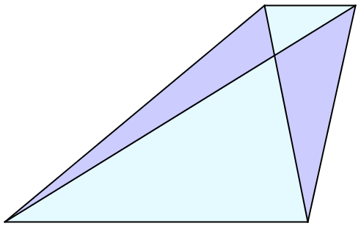




$$9$$
$$A$$
$$B$$
$$100$$
Not to scale
In this trapezium what are the areas A and B?
SIC_7
Notes:
9 100

Slide 35
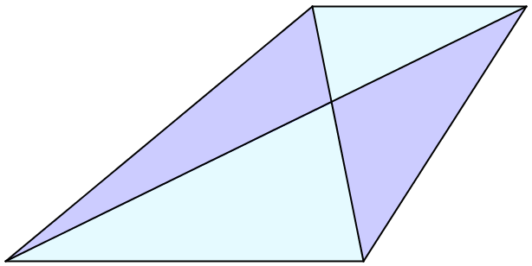




$$20$$
$$A$$
$$B$$
$$45$$
Not to scale
In this trapezium what are the areas A and B?
Notes:
20 45

Slide 36
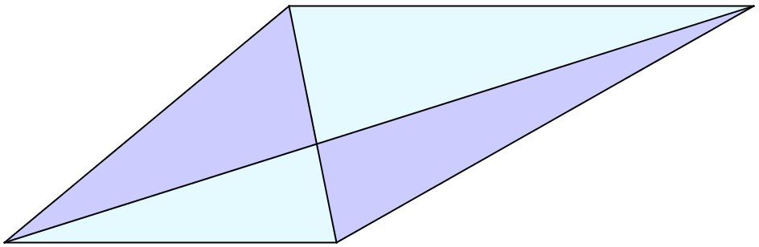




$$36$$
$$A$$
$$B$$
Not to scale
$$25$$
In this trapezium what are the areas A and B?
Notes:
36 25

Slide 37
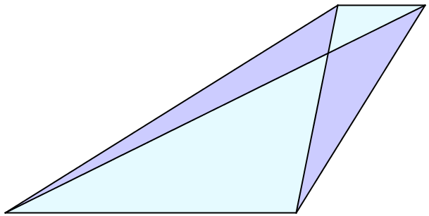




$$10$$
$$A$$
$$B$$
$$90$$
Not to scale
In this trapezium what are the areas A and B?
Notes:
10 90

